Slide 1
type of travel
accommodation
temporary
swap
internet
listings
HOUSE
SWAPPING
no cost
etiquette
limited
time
live like a local

Slide 2
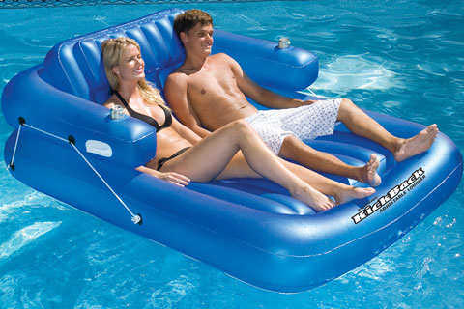
WHAT IS COUCH SURFING?

Slide 3
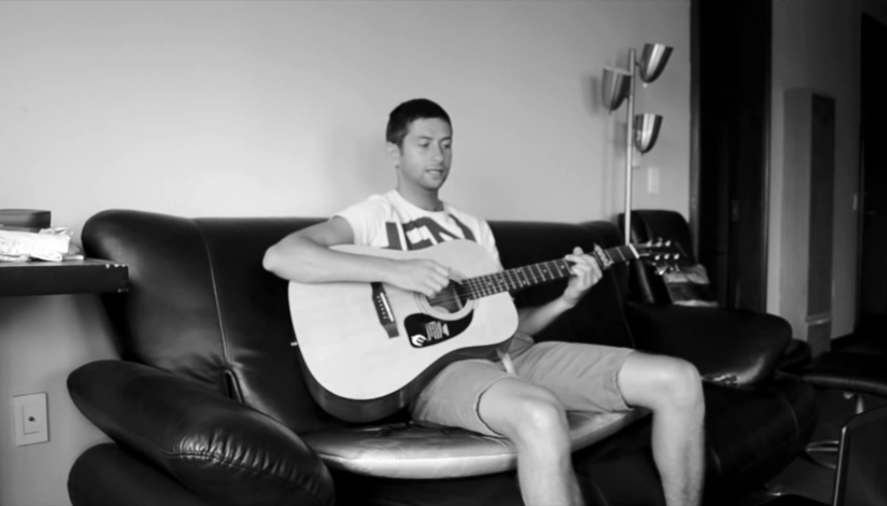

Slide 4
ACTIVITY 1

Slide 5
Would you let these surfers stay on your couch?
I
E
F
J
K
H
G
L
B
D
A
C

Slide 6
COUCH SURFER | TALLY | SCORE
A
B
C
D
E
F
G
H
I
J
K
L

Slide 7
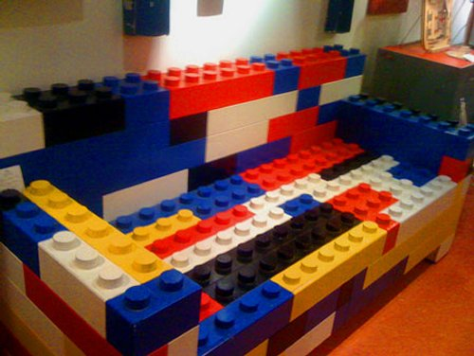
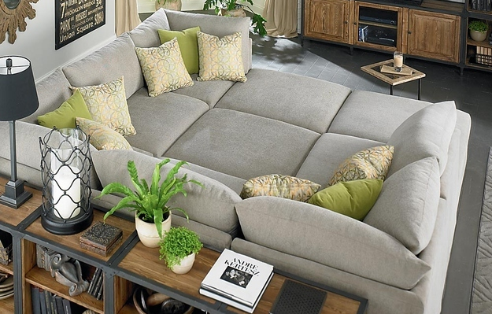
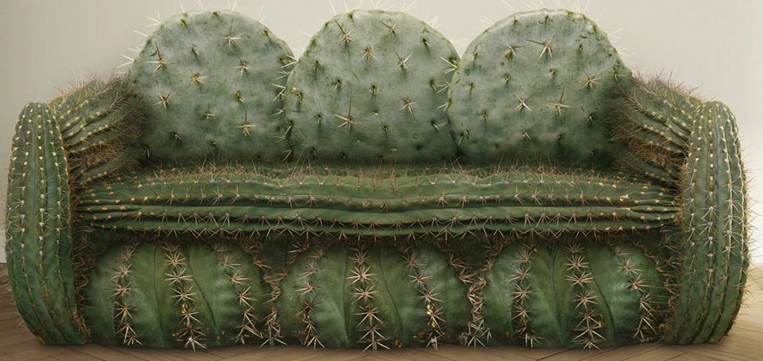
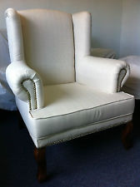
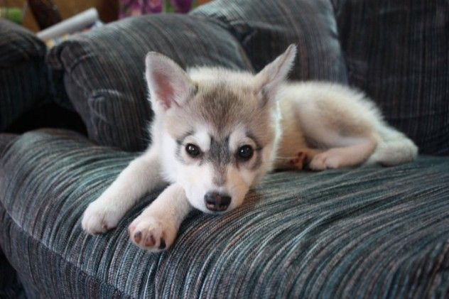
Would you couch surf on these couches?
D
B
C
E
H
A
G
F

Slide 8
COUCH | TALLY
A
B
C
D
E
F
G
H

Slide 9
What were your decisions based on?
PHYSICAL CHARACTERISTICS
weight
dress sense
beauty
age
facial hair
hairstyle & colour
EMOTIONAL CHARACTERISTICS
crazy
hospitable
polite
funny
outgoing
prideful
EVOKED FEELINGS
anxious
happy / sad
enthusiastic
disappointed
surprised
annoyed

Slide 10
What were your decisions based on?
AESTHETIC FEATURES
beauty
sublimeness (powerfulness)
compatibility (with surroundings)
quality
ASSUMED FUNCTIONALITY
fit-for-purpose
comfort
safety
added features
EVOKED FEELINGS
anxious
happy / sad
enthusiastic
disappointed
surprised
annoyed

Slide 11
ACTIVITY 2

Slide 12
ACTIVITY 2
Choose one of the couch-surfer confessions as a basis to write a short story (150-300 words) about a hypothetical couch surfing experience.

Slide 13
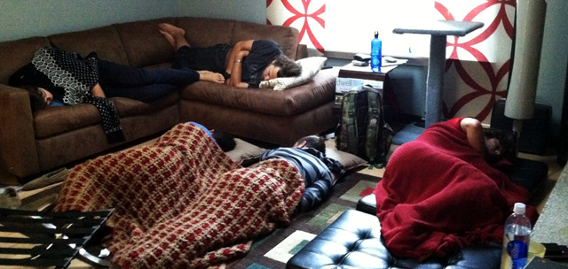
ACTIVITY 2 CONFESSION 1
There’s no room for pride when you are couch surfing. There’s only room for humility, gratefulness, and a few changes of clothes.
http://www.caitlinmuir.com/confessions-of-a-couch-surfer-part-one/
http://yobeat.yobeat.netdna-cdn.com/wp-content/uploads/2012/11/couchsurfingmain.jpg

Slide 14
ACTIVITY 2 CONFESSION 2
Be open. Open to new experiences, new types of people, and more. I can truly say it's changed my life, the way I travel, the way I learn about a country. If all you want is a free bed, don't bother.
http://www.budgettravel.com/blog/confessions-of-a-couchsurfer,12936/
http://farm6.static.flickr.com/5175/5455995366_71c21b27a0_z.jpg

Slide 15
ACTIVITY 2 CONFESSION 3
Couches are always different, and almost always, a pleasant surprise. Mine have ranged from sleeping on the floor cuddled up with a cat or a dog, to having my very own bedroom complete with king-sized bed, silk sheets, and marble ensuite.
http://matadornetwork.com/abroad/confessions-of-a-serial-couchsurfer/
http://www.globalgrasshopper.com/wp-content/uploads/2011/10/Couch-surfing11.jpg

Slide 16
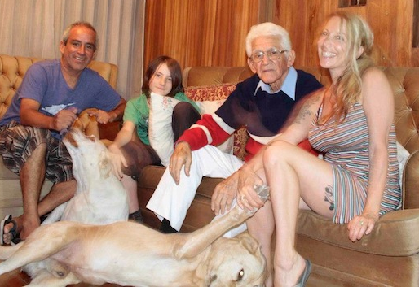
ACTIVITY 2 CONFESSION 4
I've stayed with people in their 70s who just have extra rooms in their house. They always have great stories—I've stayed with scientists, philosophers, and anthropologists—soccer moms, recently-divorced women…you'd be surprised, but they're not all just college-aged kids in their 20s.
http://www.cosmopolitan.com/advice/tips/couch-surfing

Slide 17
ACTIVITY 2 CONFESSION 5
As a solo female traveler, I’ve always been a bit wary of Couchsurfing. I noticed that many of the hosts are young, single males— I was inundated by invitations for drinks, dancing, conversation by guys in whatever city I was in.
http://www.cestchristine.com/2010/11/confessions-of-a-first-time-couchsurfer/
http://herpackinglist.com/wp-content/uploads/2013/06/should-solo-females-couchsurf.png

